Slide 1
Image Compression
with
Singular Value Decomposition
Group 1
Yashi Shukla, Shreya Reddy Pakala, Sagarika Sardesai, Sai Kaushik Soma
Nov 3, 2022

Slide 2
Sec 1: Introduction

Slide 3
Image Compression
A process applied to a graphics file to minimize its size in bytes without degrading image quality. Image compression is of 2 types, namely :
 | Lossy | Lossless
What does it do? | Permanently removes less critical information, particularly redundant data during compression. | Compresses without removing critical data or reducing image quality. Is reversible.
Where is it used? | Files where file information loss is acceptable. | Files where data loss is unacceptable
Algorithms | Discrete Cosine Transform Discrete Wavelet Transform Singular Value Decomposition | Huffman Coding Run length encoding Arithmetic Encoding
Format examples | Images : JPEG | Images : GIF, RAW, BMP, PNG
Drawbacks | Degradation Original file quality cannot be recovered | Size of compressed files is larger.

Slide 4
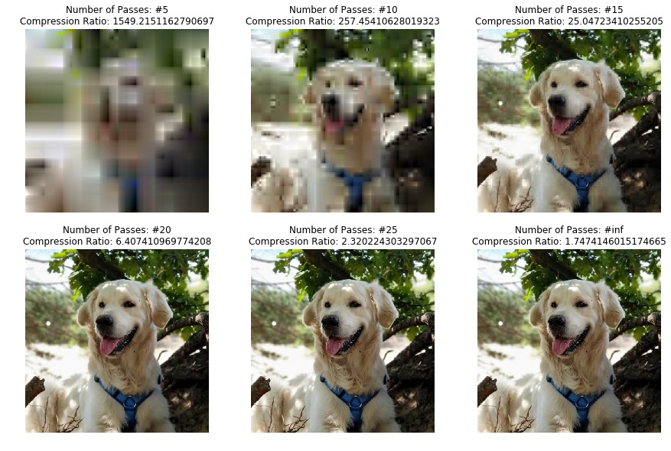
864 KB
528 KB
87 KB
271 KB

Slide 5
Why compress images?
More images can be stored in a given amount of disk or memory space.
The image requires less bandwidth when being transmitted over the internet or downloaded from a webpage,
Reduced network congestion and speeding up content delivery.
Examples of industries that utilise compression:
The Health Industry
Retail Industry
Defense and Security

Slide 6
Sec 2: Problem Formulation

Slide 7
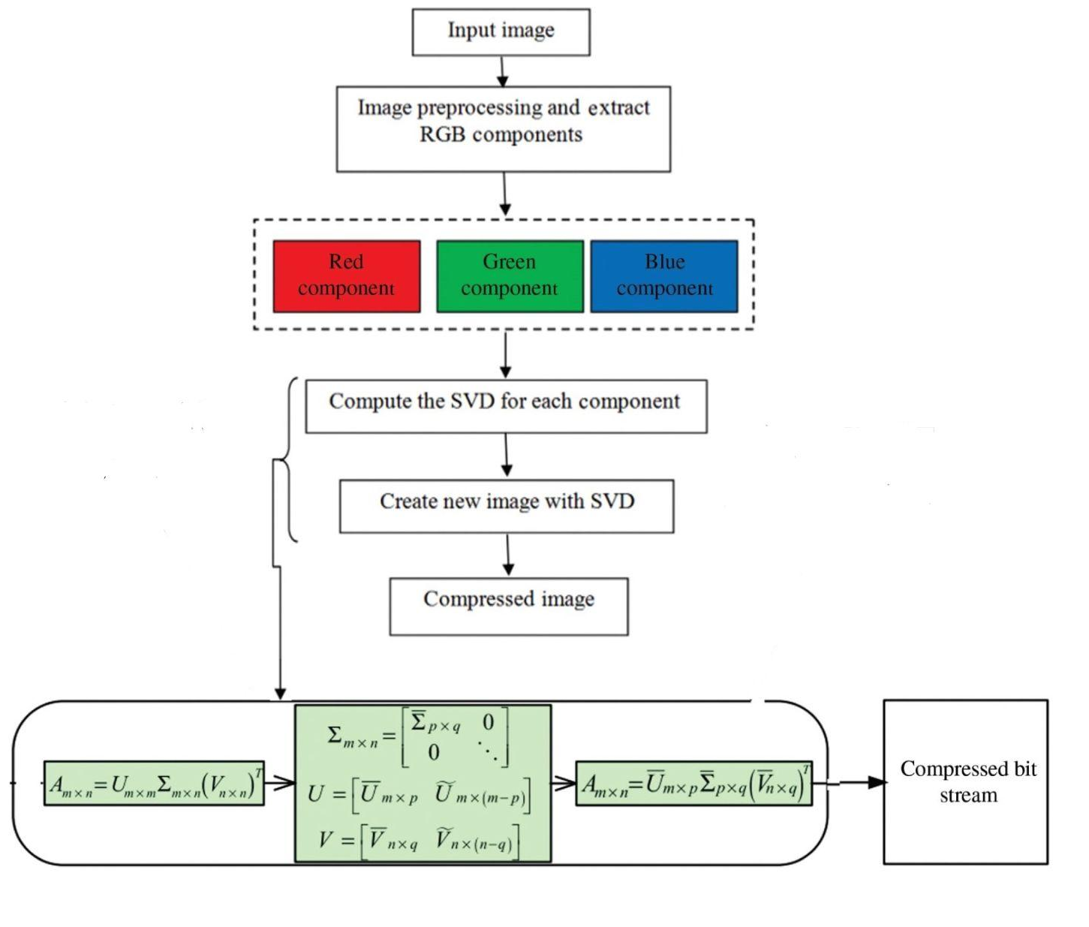
Problem Formulation and Output

Slide 8
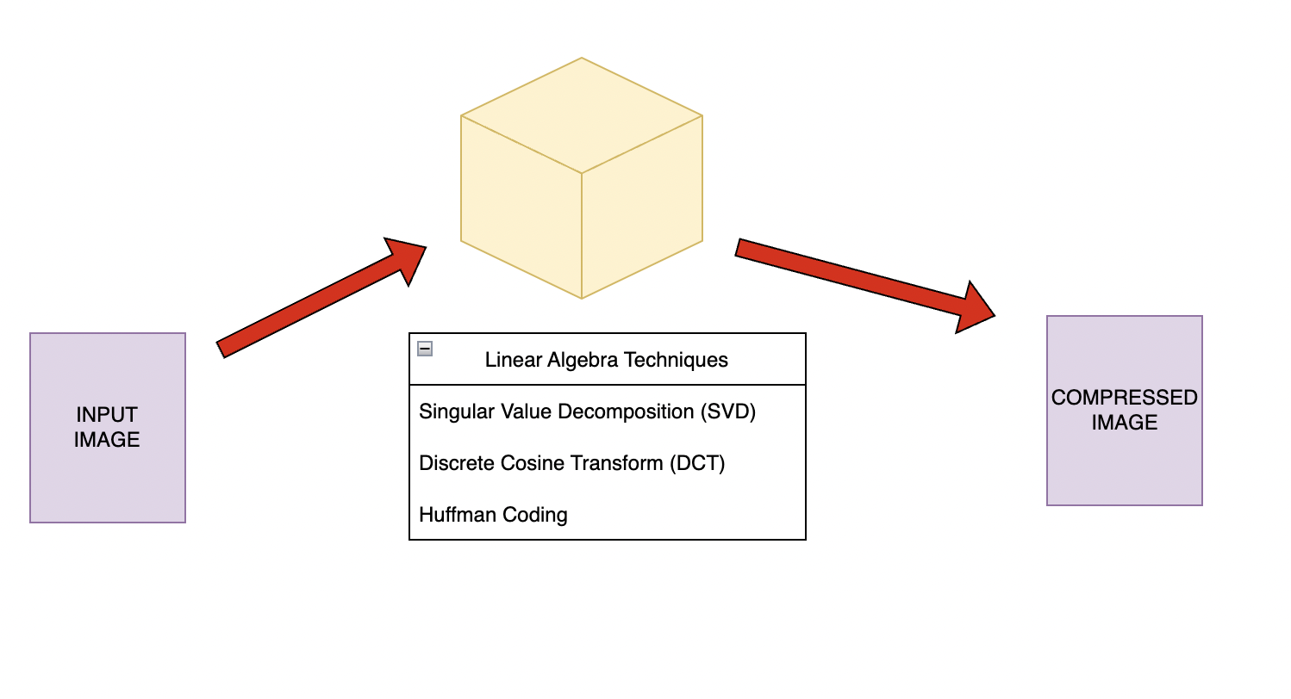
Relation to Numerical Linear Algebra

Slide 9
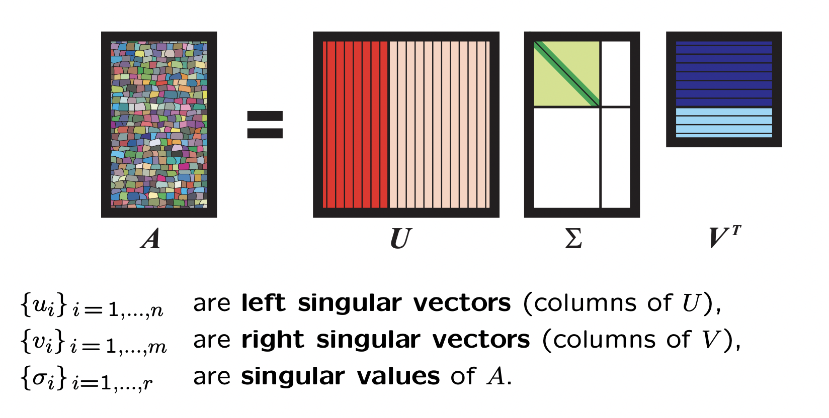
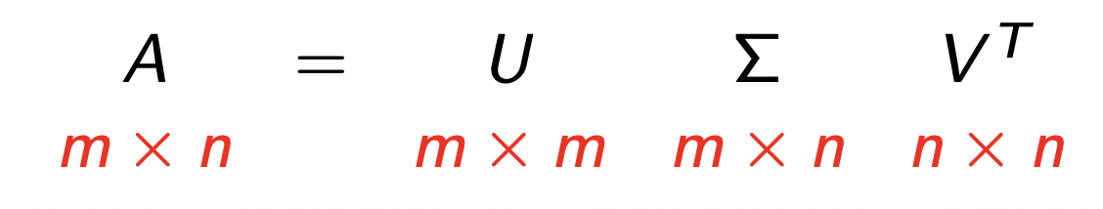
Approach of Numerical Linear Algebra (NLA)
Singular value decomposition is a factorization of a real or complex matrix. It generalizes the eigendecomposition of a square normal matrix with an orthonormal eigenbasis to any m x n matrix
A : m × n matrix with rank r
U : orthogonal m x m matrix
Σ : m x n matrix with singular entries
V : orthogonal n x n matrix
Calculating the SVD consists of finding the eigenvalues and eigenvectors of AA^{T} and A^{T}A.
The eigenvectors of A^{T}A make up the columns of V
The eigenvectors of AA^{T} make up the columns of U.
Also, the singular values in Σ are square roots of eigenvalues from AA^{T} or A^{T}A.

Slide 10
Sec 3: State of the Art (SOTA)

Slide 11
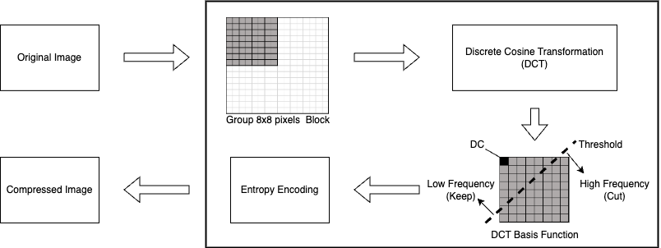
Discrete Cosine Transform (DCT)
The DCT technique works by segmenting the image into blocks, each block makes its way through each processing step and yields a compressed output.
In principle, the DCT introduces no loss to the source image samples; it transforms them to a domain in which they can be more efficiently encoded.

Slide 12
Why DCT is a better approach
SVD and DCT can easily compress an image to 30% of its original size with almost no visual difference.
However, DCT appears to be more effective because it takes its losses throughout the entire photo evenly, while SVD removes entire vectors of data at a time.
DCT’s block based approach saves a lot of computation memory compared to SVD which is performed over an entire image.
DCT provides better quality with higher compression ratios than SVD.

Slide 13
Sec 4: Experiment

Slide 14
Experimental Setup
Dataset
Libraries & Tools
Logistics
The Images 4k dataset consists of 2057 jpg images.
Python - Programming language
Matplotlib - Visualization
Numpy, Numpy.linalg, Opencv - For loading the images, Singular Value Decomposition and calculating the performance metrics
Colab - Jupyter Notebook Environment
Notion - Report Template

Slide 15
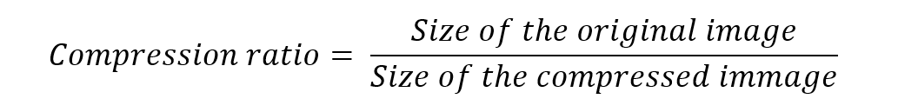
Performance Metrics
Compression Ratio
Compression Ratio is the ratio between the sizes of original image and compressed image. Higher the compression ratio, smaller the size but lower the quality of the compressed image.
Mean Squared Error (MSE)
Mean Squared Error is the average of squared errors where error is the difference between each corresponding pixel in the actual and compressed image. Lower the MSE, closer the compressed image is to the original image. MSE between two images I(x,y) and I’(x,y) is given as:

Slide 16
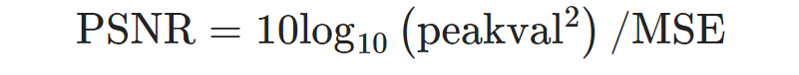
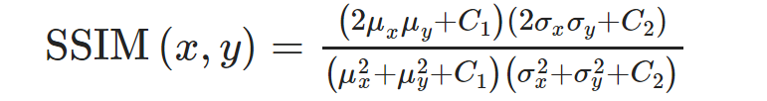
Performance Metrics (contd.)
Peak Signal to Noise Ratio (PSNR)
PSNR measures the ratio between maximum pixel intensity and the power of distorting noise affecting the quality of its representation. The noise is the error produced by compression. Higher the PSNR value, better the quality of compressed image.
where, peakval = maximum intensity value of the image; MSE = Mean Squared Error
Structural Similarity Index Measure (SSIM)
In this method, the structural similarity index calculation is based on three aspects namely: image luminance, contrast and structure. The index measures similarity between two images x and y, which can be calculated using the given formula:
where, μx and μy are the the local means, σx and σy are the standard deviations for images x and y respectively. C1 and C2 are constants used to ensure stability when denominator is close to 0.

Slide 17
Sec 5: Concluding remarks

Slide 18
Conclusion
Next Steps
Explore the Images 4k dataset
Apply SVD to the Images 4k dataset
Apply DCT to the same dataset
Compare the compression results of SVD and DCT
Expected outcome
Reduced image sizes post compression.
Increased compression resulting in more distorted images.
DCT results in a less distorted image as compared to SVD.

Slide 19
References
[1] Sara, U. et al. (2019) Image Quality Assessment through FSIM, SSIM, MSE and PSNR—A Comparative Study. Journal of Computer and Communications, 7, 8-18
[2] Asnaoui, K. (2020) Image Compression Based on Block SVD Power Method. Journal of Intelligent Systems, 29(1), 1345-1359
[3] http://people.missouristate.edu/jrebaza/assets/10compression.pdf
[4] https://www2.karlin.mff.cuni.cz/~tuma/Aplikace15/prezentace_Hnetynkova.pdf
[5] https://mse.redwoods.edu/darnold/math45/laproj/fall2016/ChristopherBingham/presentation.pdf
[6] https://web.mit.edu/be.400/www/SVD/Singular_Value_Decomposition.htm
[7] Medium. 2020. Compressing Images Using Linear Algebra. [online] Available at: https://medium.com/analytics-vidhya/compressing-images-using-linear-algebra-bdac64c5e7ef

